Slide 1


An Emotion-Aware Systems for Automated Student Engagement Assessment in Digital Learning Environments
Student:
Major:
Supervisors:
Hoang Quoc Viet, Nguyen Tien Phuc, Nguyen Ngoc Hung
Computer Science
PhD. Ma Thi Chau

Slide 2
Content
Motivation & Problem Statements
Background Concepts
Discussion
Conclusion

Slide 3




Motivation
Today’s students face increasing pressure from:
Academic workload and examinations
Family and school relationships

Slide 4

Motivation
Problem: Traditional school psychology assessments are effective but time-consuming and difficult to scale to large student populations.
Can AI support early and systematic psychological screening in schools?

Slide 5
Why Focus on Primary School Students
Primary school is a critical stage for emotional and behavioral development
Early detection has long-term preventive value.
Children have:
        + Limited self-awareness
        + Limited ability to verbalize psychological difficulties

Slide 6
Objectives of the Application
- Provide a systematic tool for student psychological assessment
- Combine:
  + Psychological questionnaires
  + AI-based facial emotion analysis
- Support teachers in:
  + Monitoring students’ mental states
  + Observing learning participation during class activities

Slide 7

Overall Concept
The application consists of two complementary components:
Psychological Questions
School-related (Learning) Questions
=> Together, they assess both psychological state and learning behavior

Slide 8
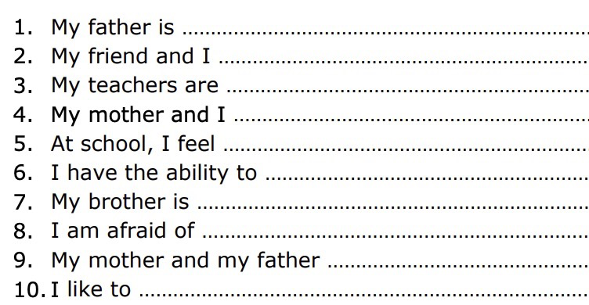
Psychological Questions
Based on the NIMHANS Sentence Completion Test:
A semi-projective psychological test for children
Developed in India
Current version: Uses the original NSCT (75 incomplete sentences)
Future plan: Develop a shortened, localized version for Vietnamese students
Notes:
Per-Vertex Coloring: Color is stored on the mesh points.
Limitation: Resolution is tied to mesh density (low detail).
UV Mapping: Unwrapping the 3D mesh onto a 2D plane. Decouples resolution from geometry.
Visual: * Implicit/Neural Representations:
NeRF/Gaussian Splatting: Texture is encoded in neural weights or point clouds. Offers infinite resolution but is harder to edit or animate in traditional pipelines.

Slide 9
Psychological Test Implementation
Students complete sentences using a keyboard
Each response is scored as:
  0 – Positive
  1 – Neutral
  2 – Negative
No absolute cutoff score
Purpose:
Screening and trend monitoring
Not a replacement for clinical diagnosis

Slide 10

Facial Emotion Data Collection
During test completion:
Webcam records facial expressions for each question
Data is sent to the server via API
AI system classifies 7 basic emotions
Emotions are mapped to the SP12 depression index

Slide 11
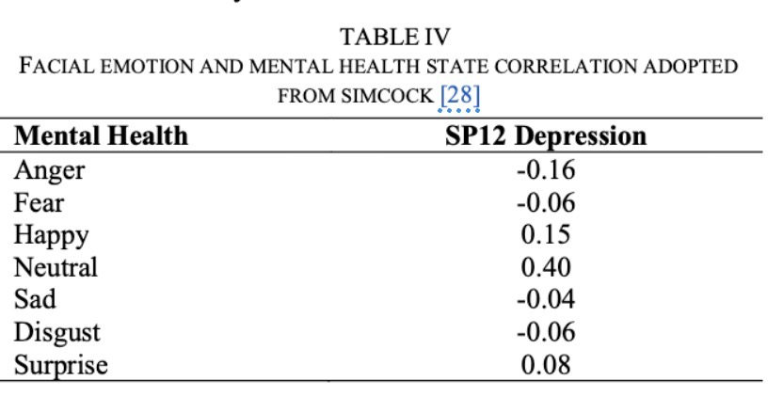
Emotional Analysis Objective
Track emotional changes throughout the test, Student’s psychological state is estimated as:
The average SP12 score over the session

Slide 12
Relationship Between Two Measurement Scales
Two Scoring Dimensions
Text-based psychological scoring (NSCT content)
Emotion-based scoring (facial expression via AI)
Original NSCT scores written content
Current application emphasizes facial emotion analysis
Key Research Question:
Do these two measurement scales support each other?
Do negative written responses correspond to negative facial emotions?

Slide 13

School-related Questions
Sources:
Life Skills Practice – Grade 4
  Emotion regulation exercises
  Fill-in-the-blank and situational questions
Life Skills Practice – Grade 5
  Multiple-choice situational questions

Slide 14
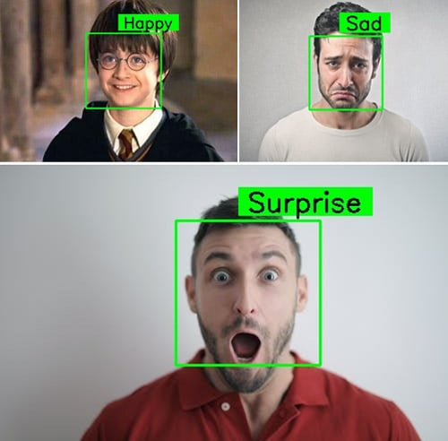
AI-based Learning Behavior Analysis
During learning tasks:
Webcam records facial video
Data sent to server via API
Video processing:
  One frame extracted every 6 frames
  Final label = most frequent prediction

Slide 15
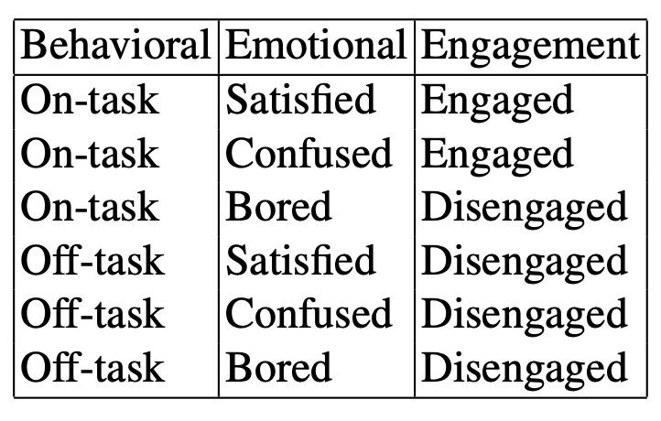
Engagement Prediction
Outputs from both models are combined
Student engagement level is predicted based on:
Behavioral: eye gaze & posture–based engagement.
Emotional: model CITA
The approach follows: model fusion

Slide 16
Scoring & Reporting
Student
Teacher
Complete tasks directly on the system
Receive: Scores
Dashboard provides aggregated statistics:
  Students with low attention
  Students showing psychological risk indicators
Supports teachers in:
  Continuous monitoring
  Early intervention

Slide 17
conclusion
The application integrates:
  Psychology
  Education
  Artificial Intelligence
Enables:
  Psychological assessment
  Analysis of emotions and behaviors during learning
Contributes to:
  School psychology support
  Social–emotional learning in education

Slide 18
Thank you for listening!

